Slide 1
AD_excitation
Xingyu Zhang
2022.11.4

Slide 2
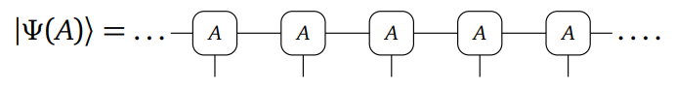
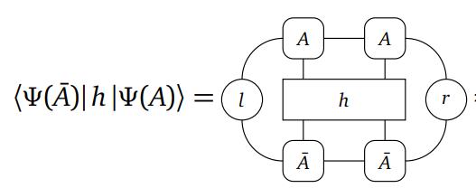
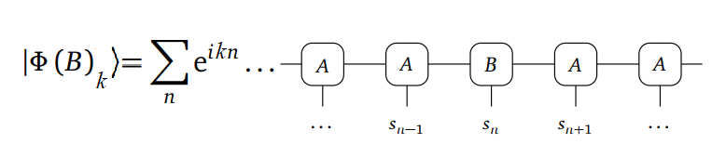
background
Ground state
Quasiparticle ansatz(single-mode approximation)

Slide 3
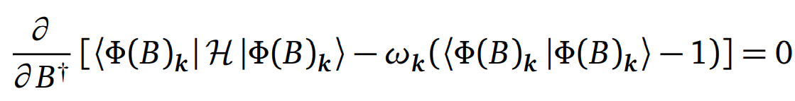
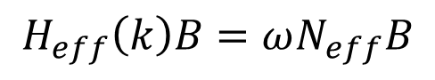
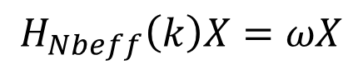
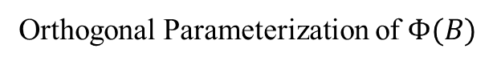
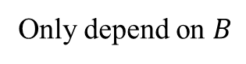
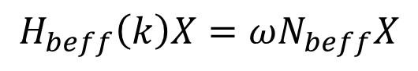
Steps summary and difficulties
graph summation
Only depend on $B$
$$H_{eff}\left(k\right)B=ωN_{eff}B$$
Orthogonal Parameterization of $Φ(B)$
$$H_{beff}\left(k\right)X=ωN_{beff}X$$
ordinary eigenvalue problem
$$H_{Nbeff}\left(k\right)X=ωX$$

Slide 4
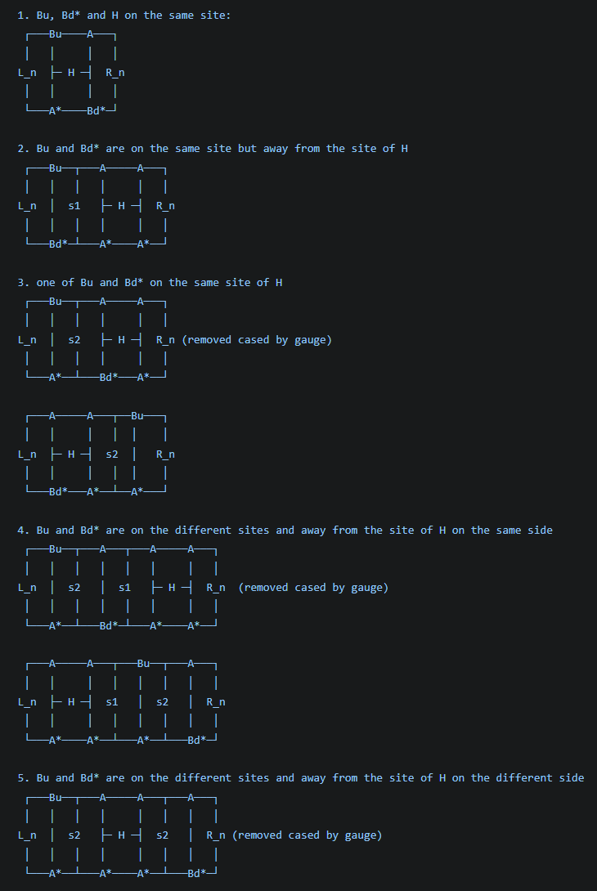
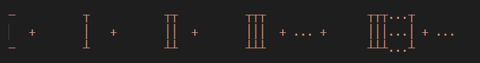
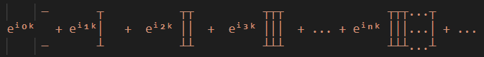
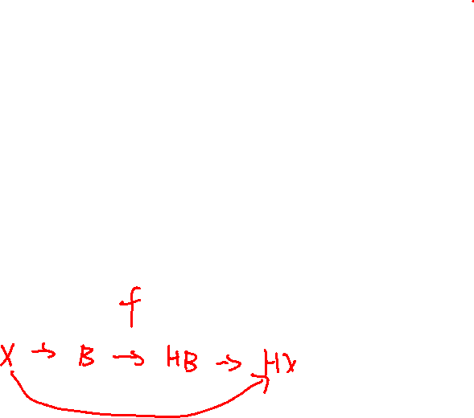
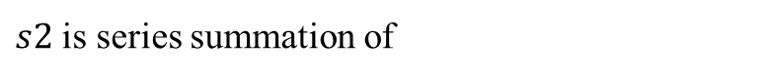
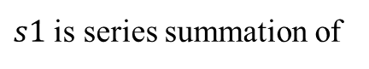
Correct graph summation
Correct series summation
$s1$ is series summation of
$s2$ is series summation of
They are divergent

Slide 5
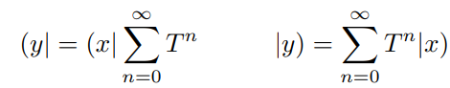
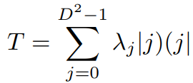
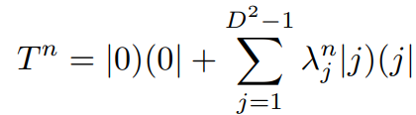
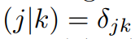
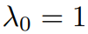
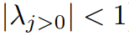
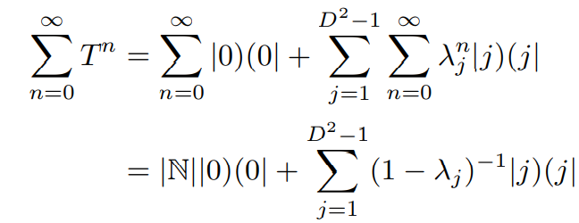
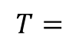
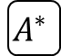

Geometric Sums of Transfer Matrices(1/3)
Geometric Sums
decomposition
$$A$$
$$T=$$
$$A^{∗}$$
divergent

Slide 6
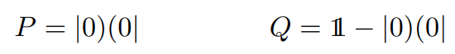
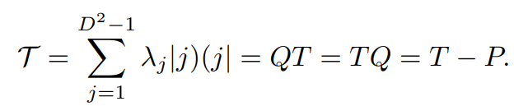
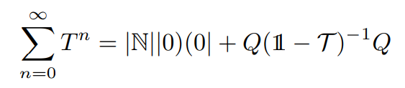
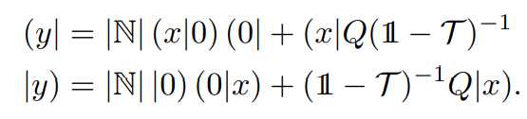
Geometric Sums of Transfer Matrices(2/3)
projectors
The diverging contributions can typically be safely discarded, as they correspond to a constant (albeit infinite) offset of some extensive observable (e.g. the Hamiltonian).

Slide 7
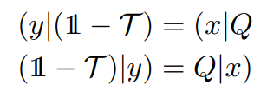
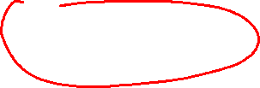
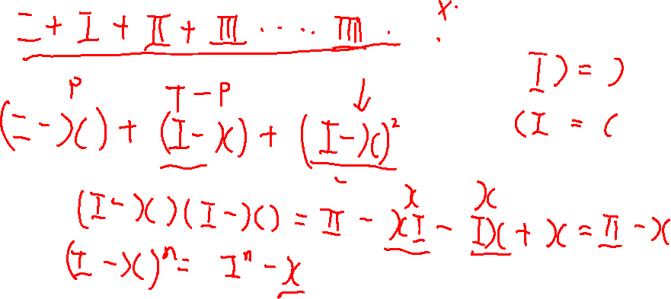
Geometric Sums of Transfer Matrices(3/3)
Linear solve

Slide 8
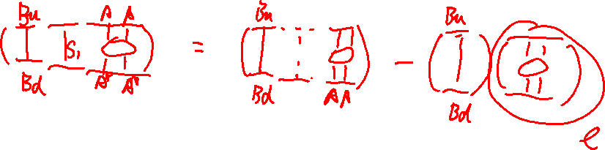

Slide 9
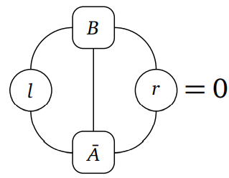
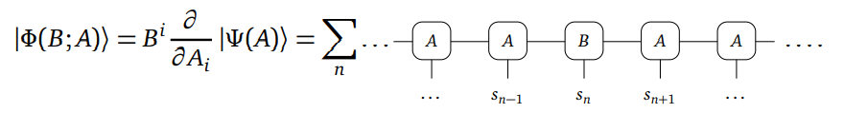
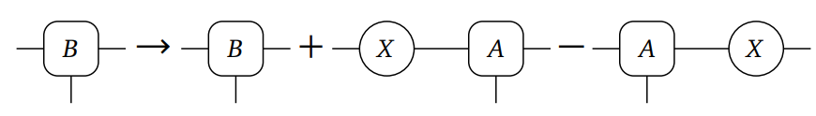
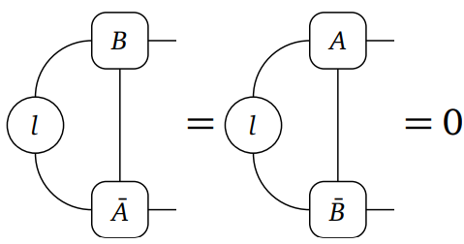
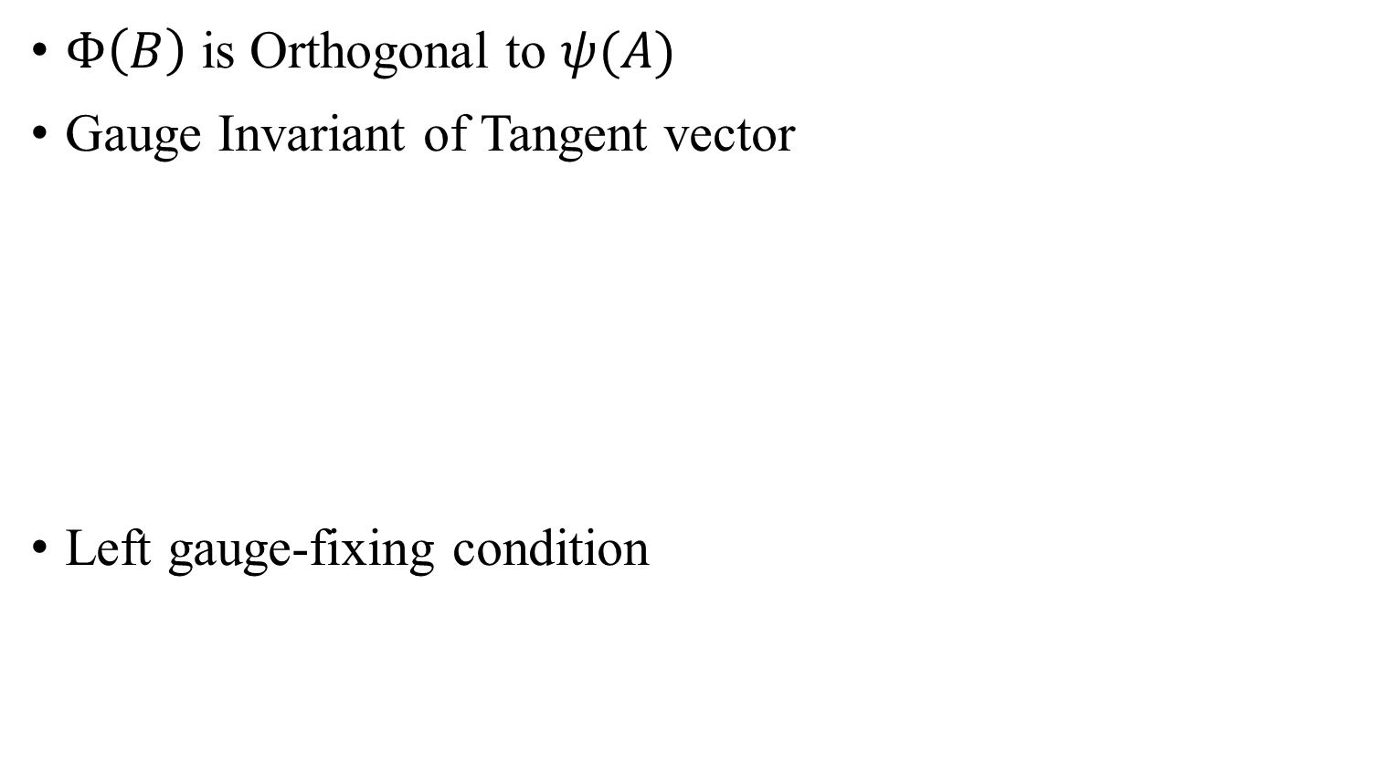
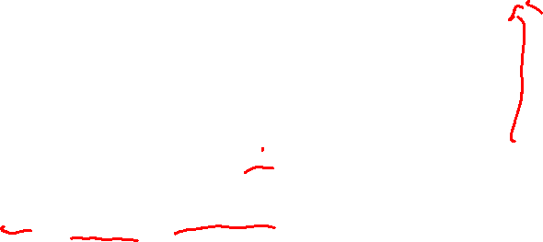
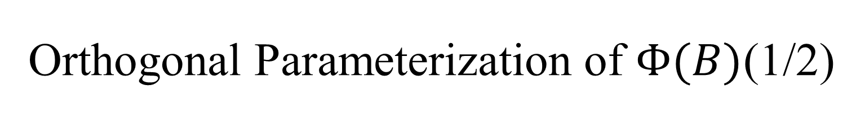
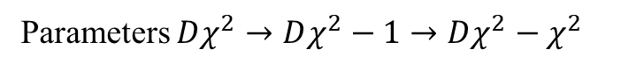
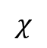
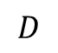
Orthogonal Parameterization of $Φ(B)$(1/2)
$$χ$$
$Φ\left(B\right)$ is Orthogonal to $ψ(A)$
Gauge Invariant of Tangent vector
Left gauge-fixing condition
$$D$$
Parameters $Dχ^{2}→Dχ^{2}−1→Dχ^{2}−χ^{2}$

Slide 10
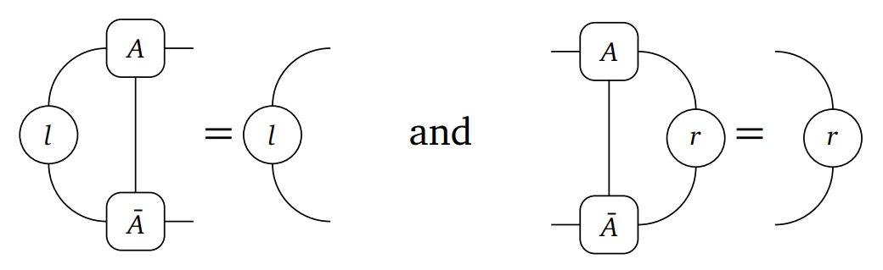
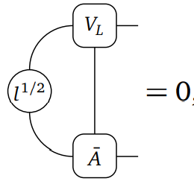
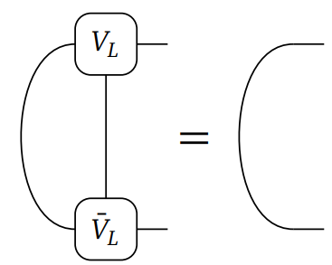
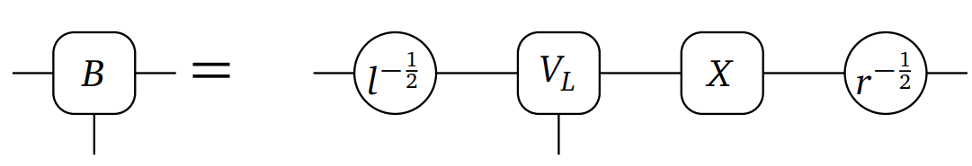
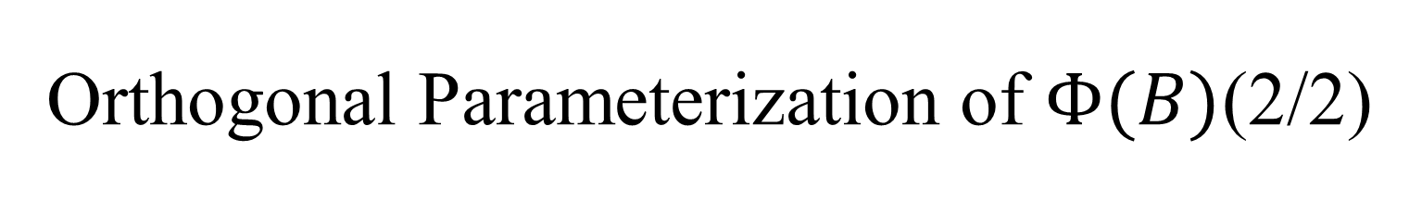
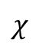
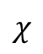
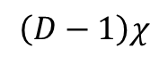

Orthogonal Parameterization of $Φ(B)$(2/2)
parameterization
$$\left(D−1\right)χ$$
$$χ$$
$$\left(D−1\right)χ$$
$$χ$$

Slide 11
test

Slide 12








ordinary eigenvalue problem
$N_{eff}→N_{beff}$
$$HX$$
=
$$l^{\frac{1}{2}}$$
$$HB$$
$$r^{\frac{1}{2}}$$
$${\overline{V}}_{L}$$

Slide 13




Ground state by AD
Heisenberg $S=1/2$

Slide 14



gap
Heisenberg $S=1/2$
Heisenberg $S=1$

Slide 15




$k = π$Haldane gap error
For $χ=256$
AD for ground state ~ 8h 10000 steps
Eigsolve for excitation state ~ 500s

Slide 16




Heisenberg $S=1$excitation spectrum

Slide 17


MPO graph summation
s2

Slide 18













MPO
TFIsing
$$2$$
$$3$$
$$\hat{W}$$
$$3$$
$$2$$
$$A$$
The 王 MPO transfer matrix contains Jordan blocks and that the dominant eigenvalue is one and of twofold algebraic degeneracy.
Overlap(E, Ǝ) = 0 E王Ǝ = 0
MPO transfer matrices technically do not have well defined fixed points. $→$ quasi fixed points
$$\hat{W}$$
$$A^{∗}$$

Slide 19








Fixed point equations
Left and right environment EƎ
$$A$$
$C_{a}=C_{a}工^{aa}+C_{a}$ $C_{a}=\sum_{b>a}{C_{b}}工^{ba}$
$Ɔ_{a}=工^{aa}Ɔ_{a}+Ɔ_{a}$ $Ɔ_{a}=\sum_{b<a}{ }工^{ab}$ $Ɔ_{b}$
$${ \hat{W}}^{ab}$$
$工^{ab}$=
$工^{aa}=0$
$$C_{a}=C_{a}$$
$$Ɔ_{a}=Ɔ_{a}$$
$工^{aa}=λ_{a}工$
$C_{a}={λ_{a}C}_{a}工+C_{a}$ $C_{a}(1−λ_{a}工)=C_{a}$
$Ɔ_{a}=λ_{a}工Ɔ_{a}+Ɔ_{a}$ ${(1−λ_{a}工)Ɔ}_{a}=Ɔ_{a}$
$工^{aa}=工$
$C_{a}(1−工)=C_{a}$
$$(1−工)Ɔ_{a}=Ɔ_{a}$$
$$C_{a}\left(1−工−\text{ɔ}c\right)=C_{a}−C_{a}\text{ɔ}\text{c}$$
$$\left(1−工−\text{ɔ}c\right)Ɔ_{a}=Ɔ_{a}−\text{ɔ}cƆ_{a}$$
energy= $cƆ_{w}$= $C_{1}\text{ɔ}$
$$A^{∗}$$
$$A$$
工=
$$A^{∗}$$

Slide 20


Slide 21
2D excitation spectrum on helix
Xingyu Zhang
2023.1.5

Slide 22


Review and contents
single-mode approximation
1D excitation spectrum
Orthogonal Parameterization
Graph summation
Eigen equation
Two site Hamiltonian
MPO (much simpler! quasi fixed points)
2D excitation spectrum
1D to 2D
cylinders
Large unit cell; $k_{y}$ is not a good quantum number
helix
Single unit cell; $k_{y}$ is a good quantum number

Slide 23



Direct 2D single-mode approximation
High computational cost
No innovation point

Slide 24



1D$→$2D map
Cylinder
Helix
$$W$$

Slide 25









1D$→$2D map
Cylinder
Helix
$W=4$ for example
NN
NN
1,3,4
$$A_{1}$$
1, 4
$$A$$
1, 4
$$A_{2}$$
1, 4
$$A$$
1, 4
$$A_{2}$$
1, 4
$$A$$
1,3,4
$$A_{1}$$
1, 4
$$A$$
Unit cell length=4
Single unit!

Slide 26













MPO from matrix product (MP) diagram
1D TFIsing
1D Heisenberg
$$H=\sum_{i}{−σ_{i}^{z}σ_{i+1}^{z}−λσ_{i}^{x}}$$
$$=−σ_{1}^{z}σ_{2}^{z}I_{3}I_{4}…−σ_{1}^{x}I_{2}I_{3}I_{4}$$
$−{I_{1}σ}_{2}^{z}σ_{3}^{z}I_{4}…−I_{1}σ_{2}^{x}I_{3}I_{4}$
$−{I_{1}I_{2}σ}_{3}^{z}σ_{4}^{z}…−I_{1}I_{2}σ_{3}^{x}I_{4}$
$$H=\sum_{i}{{S_{i}^{x}S_{i+1}^{x}+S_{i}^{y}S_{i+1}^{y}+S}_{i}^{z}S_{i+1}^{z}}$$
1
$$I$$
2
$$S^{x}$$
1
$$I$$
3
$$S^{y}$$
2
$$σ^{x}$$
$$S^{z}$$
3
$$σ^{z}$$
4
2
5
N
N
$$M=\left[\begin{matrix}I & S^{x} & S^{y} & S^{z} & 0 \\ 0 & 0 & 0 & 0 & S^{x} \\ 0 & 0 & 0 & 0 & S^{y} \\ 0 & 0 & 0 & 0 & S^{z} \\ 0 & 0 & 0 & 0 & I\end{matrix}\right]$$
2
$$M=\left[\begin{matrix}I & −σ^{z} & {−σ}^{x} \\ 0 & 0 & σ^{z} \\ 0 & 0 & I\end{matrix}\right]$$
$$N=3$$
$$N=5$$

Slide 27







MPO from matrix product (MP) diagram
TFIsing
Heisenberg
NN NN-2
NN NN-2
1
$$I$$
2
$$σ^{x}$$
1
$$I$$
$$σ^{z}$$
2
$$S^{x}$$
3
$$S^{y}$$
4
3
$$S^{z}$$
4
NN NN-3
5
1
6
2
7
3
N=2+W
N= 2+3W
8
4
2
5
N
N
2

Slide 28





Ground state vumps
1D TFIsing NN
1D Heisenberg NN
$$λ_{c}=\text{1}$$
$S=1$ Haldane gap

Slide 29






Ground state vumps
2D TFIsing
2D Heisenberg NN
$$λ_{c}=\text{3.04438}$$
Different approach with $D$ v.s. $W$
Nonmonotonicity with $W$ and $χ$

Slide 30





excitation spectrum
Cylinder
Helix
$$\left.\left|Φ_{k_{x},k_{y}}(B)\right.\right\rangle =\sum_{n}{e^{ik_{x}\text{⌊}\text{n}\text{/}\text{W}\text{⌋}+ik_{y}(n mod W)}T_{x}T_{y}}$$
No $k_{y}$ because $k_{y}$ is not a good quantum number
$k_{y}$ is a good quantum number
Recover by directly calculating

Slide 31





translation operator
$$\left.\left|Φ{\left(B\right)}_{k}\right.\right\rangle =e^{ik ⋅0}$$
$+$ $e^{ik ⋅1}$
$+$ $e^{ik ⋅2}$
$+$ $e^{ik ⋅3}$
$$B$$
$$\left.T\left|Φ{\left(B\right)}_{k}\right.\right\rangle =e^{ik ⋅0}$$
$+$ $e^{ik ⋅1}$
$+$ $e^{ik ⋅2}$
$+$ $e^{ik ⋅3}$
$$B$$
$$\left.e^{−ik}\left|Φ{\left(B\right)}_{k}\right.\right\rangle =\left.T\left|Φ{\left(B\right)}_{k}\right.\right\rangle$$

Slide 32





translation operator $T_{y}$
$$T_{y}$$
Cylinder
$W=4$ for example
$$T_{x}$$
$$\left.\left|Φ{\left(B\right)}_{k_{x},k_{y}}\right.\right\rangle =e^{ik_{x} ⋅0+ik_{y}⋅0} +e^{ik_{x} ⋅0+ik_{y}⋅1}$$
$+e^{ik_{x} ⋅0+ik_{y}⋅2} +e^{ik_{x} ⋅0+ik_{y}⋅3}$
$$T_{y}$$

Slide 33


translation operator $T_{y}$
$$T_{y}$$
Cylinder
$W=4$ for example
$$T_{x}$$
$$\left.\left|Φ{\left(B\right)}_{k_{x},k_{y}}\right.\right\rangle =e^{ik_{x} ⋅0+ik_{y}⋅0} +e^{ik_{x} ⋅0+ik_{y}⋅1}$$
$+e^{ik_{x} ⋅0+ik_{y}⋅2} +e^{ik_{x} ⋅0+ik_{y}⋅3}$
$$T_{y}$$
$k_{y}$is not a good quantum number!

Slide 34



translation operator $T_{y}$
$$T_{y}$$
Helix
$W=4$ for example
$$T_{x}$$
$$\left.\left|Φ{\left(B\right)}_{k_{x},k_{y}}\right.\right\rangle =e^{ik_{x} ⋅0+ik_{y}⋅0} +e^{ik_{x}⋅0+ik_{y}⋅1}$$
$+e^{ik_{x}⋅0+ik_{y}⋅2} +e^{ik_{x}⋅0+ik_{y}⋅3}$
$$T_{y}$$
$k_{y}$is a good quantum number!

Slide 35

Graph summation

Slide 36


Graph summation
$$\left|\left.\right\rangle \right.=e^{ik ⋅0+ik_{y}⋅0}$$
$W=4$ for example
$$S^{+_{1}}=e^{ik_{x}⋅0+ik_{y}⋅1}三+e^{ik_{x}⋅0+ik_{y}⋅2}王+e^{ik_{x}⋅0+ik_{y}⋅3}王^{2}$$
$$\left\langle \left.\right|\right.=$$
$${+e}^{ik_{x}⋅1+ik_{y}⋅0}王^{3}+e^{ik_{x}⋅1+ik_{y}⋅1}王^{4}+e^{ik_{x}⋅1+ik_{y}⋅2}王^{5}+e^{ik_{x}⋅1+ik_{y}⋅3}王^{6}$$

Slide 37



Graph summation
$$S^{+_{1}}=\left(e^{ik_{x}⋅0+ik_{y}⋅1}三+e^{ik_{x}⋅0+ik_{y}⋅2}王+e^{ik_{x}⋅0+ik_{y}⋅3}王^{2}{+e}^{ik_{x}⋅1+ik_{y}⋅0}王^{3}\right)⋅$$
$$\left(三+e^{ik_{x}⋅1}王^{4}+e^{ik_{x}⋅2}王^{8}+…\right)$$
$$≡\left(e^{ik_{x}⋅0+ik_{y}⋅1}三+e^{ik_{x}⋅0+ik_{y}⋅2}王+e^{ik_{x}⋅0+ik_{y}⋅3}王^{2}{+e}^{ik_{x}⋅1+ik_{y}⋅0}王^{3}\right)S_{4}^{+}$$
$$S^{+}=S^{+_{1}}+S^{+_{2}}+S^{+_{3}}+S^{+_{4}}=\left(\left({3e}^{ik_{x}⋅0+ik_{y}⋅1}+e^{ik_{x}⋅1−ik_{y}⋅3}\right)三+\left(2e^{ik_{x}⋅0+ik_{y}⋅2}+2e^{ik_{x}⋅1−ik_{y}⋅2}\right)王+{(e}^{ik_{x}⋅0+ik_{y}⋅3}+3e^{ik_{x}⋅1−ik_{y}⋅1})王^{2}{+4e}^{ik_{x}⋅1+ik_{y}⋅0}王^{3}\right)S_{4}^{+}$$
Same way:
$$S^{−}=S^{−_{1}}+S^{−_{2}}+S^{−_{3}}+S^{−_{4}}=\left(\left({3e}^{ik_{x}⋅0−ik_{y}⋅1}+e^{−ik_{x}⋅1+ik_{y}⋅3}\right)三+\left(2e^{ik_{x}⋅0−ik_{y}⋅2}+2e^{−ik_{x}⋅1+ik_{y}⋅2}\right)王+{(e}^{ik_{x}⋅0−ik_{y}⋅3}+3e^{−ik_{x}⋅1+ik_{y}⋅1})王^{2}{+4e}^{−ik_{x}⋅1+ik_{y}⋅0}王^{3}\right)S_{4}^{−}$$
$$S_{4}^{−}=\left(三+e^{−ik_{x}⋅1}王^{4}+e^{−ik_{x}⋅2}王^{8}+…\right)$$

Slide 38




result
2D TFIsing $k_{y}=0$

Slide 39




result
2D TFIsing $k_{y}=π$

Slide 40



result

Slide 41
outlook
1D anti-Heisenberg, Large unit cell
2D anti-Heisenberg
Kitaev

Slide 42
Thank you for listening!
Q&A?

Slide 43
2D excitation spectrum on helix
Xingyu Zhang
2023.3.31

Slide 44
Review
single-mode approximation
1D excitation spectrum
Single unit cell
good quantum number
helix
2D excitation spectrum
TFIsing result：
Non-symmetry by
Finite width effect

Slide 45



mitigate finite effect
TFIsing
Heisenberg

Slide 46



$k_{x}=0$ is more accurate
TFIsing

Slide 47
Graph summation

Slide 48
Graph summation
$$\left|\left.\right\rangle \right.=e^{ik ⋅0+ik_{y}⋅0}$$
$W=4$ for example
$$S^{+_{1}}=e^{ik_{x}⋅0+ik_{y}⋅1}三+e^{ik_{x}⋅0+ik_{y}⋅2}王+e^{ik_{x}⋅0+ik_{y}⋅3}王^{2}$$
$$\left\langle \left.\right|\right.=$$
$${+e}^{ik_{x}⋅1+ik_{y}⋅0}王^{3}+e^{ik_{x}⋅1+ik_{y}⋅1}王^{4}+e^{ik_{x}⋅1+ik_{y}⋅2}王^{5}+e^{ik_{x}⋅1+ik_{y}⋅3}王^{6}$$

Slide 49


mitigate finite effect

Slide 50

asymptotic behavior

Slide 51



Prepare for $J_{1}−J_{2}$ model

Slide 52


Merge 4 site ground energy
Heisenberg

Slide 53


Merge 4 site ground energy
$$J_{1}−J_{2}$$

Slide 54



















MPO from MP diagram
1
1
4
Heisenberg
On site term in cells
coupling between cells
2
2
2
3
$$1+W$$
2
3
4
$$2+W$$
3
5
$$1+2W$$
1
6
$$2+2W$$
$$I⨂I⨂I⨂I$$
7
$$1+3W$$
$${IS}^{x}$$
8
$$2+3W$$
$${IS}^{y}$$
$${IS}_{n}^{α}≡I⨂S_{n}^{α}…I⨂I$$
9
$$1+4W$$
$${IS}^{z}$$
10
$$\sum_{α}{\begin{aligned}S^{α}⨂S^{α}⨂I⨂I+S^{α}⨂I⨂S^{α}⨂I \\ \text{+}I⨂S^{α}⨂I⨂S^{α}\text{+} I⨂I⨂S^{α}⨂S^{α}\end{aligned}}$$
$$2+4W$$
11
$$1+5W$$
12
$$2+5W$$
13
$$1+6W$$
$$N=2+6W$$
14
$$2+6W$$

Slide 55































MPO from MP diagram
1
1
J1-J2
4
2
2
1+2
$$W$$
3
4
$$1+W$$
$$I⨂I⨂I⨂I$$
5
1+3
$$2+W$$
$${IS}^{x}$$
2
1
$${IS}_{n}^{α}≡I⨂S_{n}^{α}…I⨂I$$
6
$$3+W$$
$${IS}^{y}$$
7
$$1+2W$$
$${IS}^{z}$$
8
3
$$2+2W$$
$$\sum_{α}{\begin{aligned}{{\text{+}\text{J}}_{1}S}^{α}⨂S^{α}⨂I⨂I+{{\text{J}}_{1}S}^{α}⨂I⨂S^{α}⨂I \\ {\text{+}\text{J}}_{1}I⨂S^{α}⨂I⨂S^{α}\text{+}{\text{J}}_{1}I⨂I⨂S^{α}⨂S^{α} \\ {\text{+}\text{J}}_{2}S^{α}⨂I⨂I⨂S^{α}{\text{+}\text{J}}_{2}I⨂S^{α}⨂S^{α}⨂I\end{aligned}}$$
9
1+3
$$3+2W$$
3
10
1+2
$$4+2W$$
11
$$2+3W$$
12
$$3+3W$$
13
$$4+3W$$
14
$$5+3W$$
15
$$3+4W$$
$$N=8+6W$$
16
$$4+4W$$
17
$$5+4W$$
18
$$6+4W$$
19
$$4+5W$$
20
$$5+5W$$
21
$$6+5W$$
22
$$7+5W$$
23
$$5+6W$$
24
$$6+6W$$
25
$$7+6W$$
26
$$8+6W$$

Slide 56














MPO from MP diagram
1
1
2+4
Heisenberg
On site term in cells
coupling between cells
2
2
3
4
$$1+W$$
4
1+3
5
$$2+W$$
6
$$I⨂I⨂I⨂I$$
7
$${IS}^{x}$$
2
$${IS}_{n}^{α}≡I⨂S_{n}^{α}…I⨂I$$
8
$$2+2W$$
$${IS}^{y}$$
9
1
$${IS}^{z}$$
$$3+2W$$
10
$$\sum_{α}{\begin{aligned}S^{α}⨂S^{α}⨂I⨂I+S^{α}⨂I⨂S^{α}⨂I \\ \text{+}I⨂S^{α}⨂I⨂S^{α}\text{+} I⨂I⨂S^{α}⨂S^{α}\end{aligned}}$$
$$1+3W$$
3+4
3
11
$$2+3W$$
12
1+2
13
$$N=2+9W$$
14
$$2+6W$$

Slide 57


2D Fold Brillouin zone

Slide 58

1D Fold Brillouin zone
1D MPS merge 2 site
Heisenberg

Slide 59













Expanded Brillouin zone
$$\left.\left|Φ{\left(B\right)}_{k}\right.\right\rangle =e^{ik ⋅0}$$
$+$ $e^{ik ⋅1}$
$+$ $e^{ik ⋅2}$
$+$ $e^{ik ⋅3}$
$$B$$
$$a=1$$
$$k∈\left(−\frac{π}{a},\frac{π}{a}\right)=\left(−π,π\right)$$
$$\left.\left|Φ{\left(\tilde{B}\right)}_{\tilde{k}}\right.\right\rangle =e^{i\tilde{k} ⋅0}$$
$+$ $e^{i\tilde{k} ⋅1}$
$$\tilde{B}$$
$$\tilde{a}=\frac{1}{2}$$
$$\tilde{k}∈\left(−\frac{π}{\tilde{a}},\frac{π}{\tilde{a}}\right)=\left(−2π,2π\right)$$
$$\left.\left|Φ{\left(\tilde{B}\right)}_{\tilde{k}}\right.\right\rangle =e^{i\tilde{k} ⋅0}$$
$+$ $e^{i\tilde{k} ⋅2}$
$$\tilde{B}$$
$k=0$and$k=π$ are folded on the $\tilde{k}=0$!
$$\tilde{a}=1$$
$$\tilde{k}∈\left(−\frac{π}{\tilde{a}},\frac{π}{\tilde{a}}\right)=\left(−π,π\right)$$

Slide 60







2D Fold Brillouin zone
$$B$$
$$e^{ik_{y}}$$
$$e^{ik_{x}+ik_{y}}$$
$$\tilde{B}$$
$$1$$
$$e^{ik_{x}}$$
$k=\left(0,0\right),\left(π,0\right),\left(0,π\right),(π,π)$ are folded on the $\tilde{k}=(0,0)$!

Slide 61

Higher energy excitation
0.399593, 0.401682, 1.41092, 1.5529, 1.558, 2.15555, 2.21871, 2.26231, 2.28512, 2.29263

Slide 62

Select excitation state

Slide 63


spectral weight

Slide 64

spectral weight

Slide 65

Summary and outlook
mitigate finite effect by approximation of summation
4 site merge for computation of complex configuration
Find original spectral weight in folded Brillouin zone
Outlook
J1-J2 excitation at $\left(π,π\right)$and$(π,0)$
Kitaev

Slide 66
Thank you for listening!
Q&A?

